Slide 1
NUTRITION aNALYSIS USING IMAGE CLASSIFICATION BY DEEP LEARNING & CONVOLUTION NEURAL NETWORK Smart-Bridge Remote Internship Program 2020
Developed By: Vivek Gupta
Darshan Gondakar
Dhanush G Pattanashetti
Niranjan S
Sayed Maaz

Slide 2
TABLE OF CONTENTS
Introduction
Purpose
Block Diagram
Flow Chart
Required Tools & Software
Experimental Investigation
Advantages and Disadvantages
Conclusion

Slide 3
INTRODUCTION
In the current age, people are more conscious about their fruit and diet to avoid either upcoming or existing diseases .In order to properly assess dietary intake, accurate estimation of calorie value of fruit is a paramount importance. Due to the advances in various technologies used in smart phones, their computational power has also increased .They are capable of processing real-time multi-media information with their computational power. Since the present smart phones can handle the high-quality images too, research on fruit classification is focused on developing real-time applications which capture images and train the machine learning models instantly.
Since the CNNs are capable of handling a large amount of data and can estimate the features automatically, they have been utilized for the task of food classification. The standard Fruits dataset has been selected as the working database for this approach.
A majority of the people are overeating and not being active enough. Given how busy and stressed people are today, it’s effortless to forget to keep track of the food that they eat. This only increases the importance of proper classification of nutrition of fruit.

Slide 4
PURPOSE
Our aim of the project is to make use of Tensorflow, keras libraries from python for Deep learning apply it on Nutrition analysis.
Secondly, to learn how to use hyper tune parameters applications using convolution neural networks (CNNs) algorithm.
And in the end, to predict the fruits image classification and get the nutrition value of the respective fruits using Deep learning algorithms and withdrawing the conclusions .

Slide 5
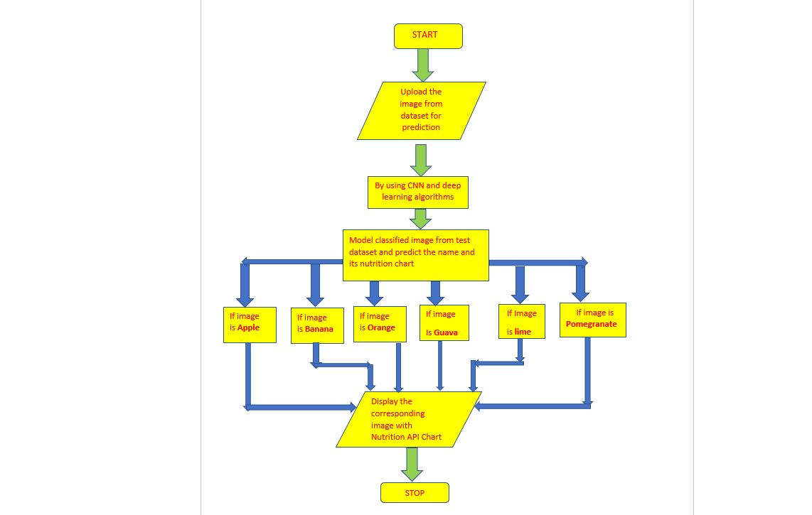
FLOW CHART

Slide 6
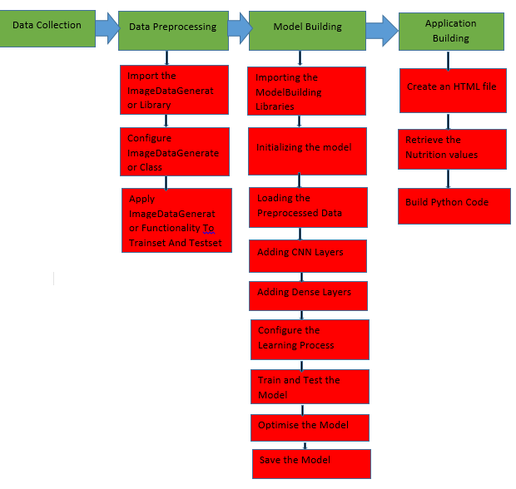
BLOCK DIAGRAM:

Slide 7
REQUIREd TOOLS & SOFTWARES
Jupyter Notebook Environment
Spyder IDE
Deep Learning Algorithms
Python (Sequential, Dense, Conv2D, MaxPool2D, Flatten)
HTML
Flask
We developed this Nutrition analysis by using Python, which is a high-level programming language along with Deep Learning Algorithm such as CNN. For model development and flask application we used Anaconda distributions like jupyter and Spyder, an integrated scientific programming in python language. Flask is used as a user interface for the prediction. Hypertext Markup Language (HTML) is the standard markup language for documents designed to be displayed in a web browser.

Slide 8
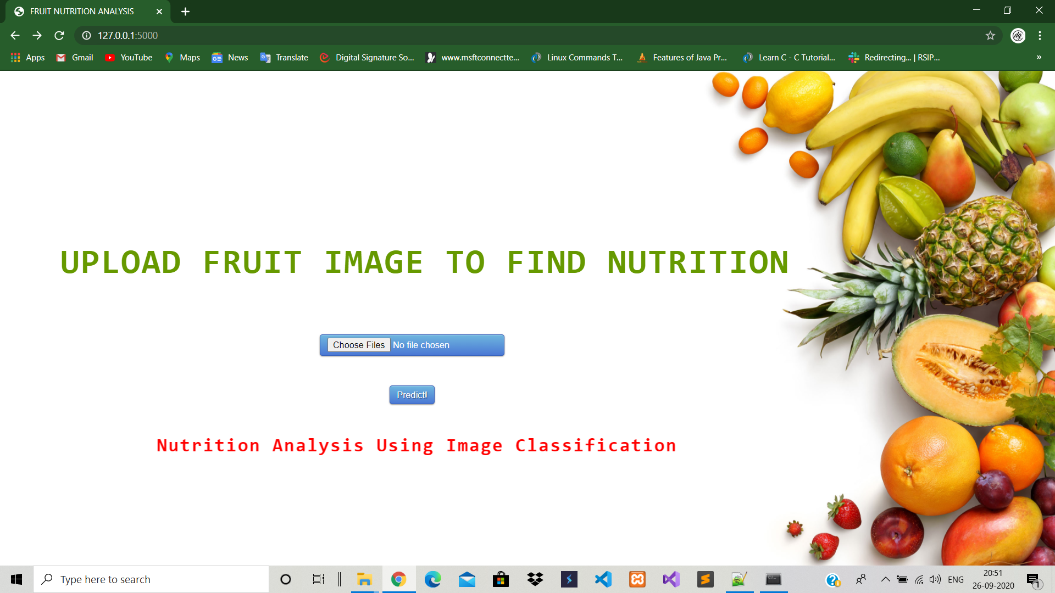
EXPERIMENTAL INVESTIGATION
(a)Home Page
In our project, we have used the fruit dataset. This dataset contains two folders: test set and train set. In both the test set and train set, we have six categories namely Apple, Banana, Guava, Lime, Mango and Pomegranate, where each category contains several number of fruits of its type which constitutes to the total fruit images of 4800 images belonging to 6 classes in train set and 1200 images belonging to 6 classes in test set.

Slide 9
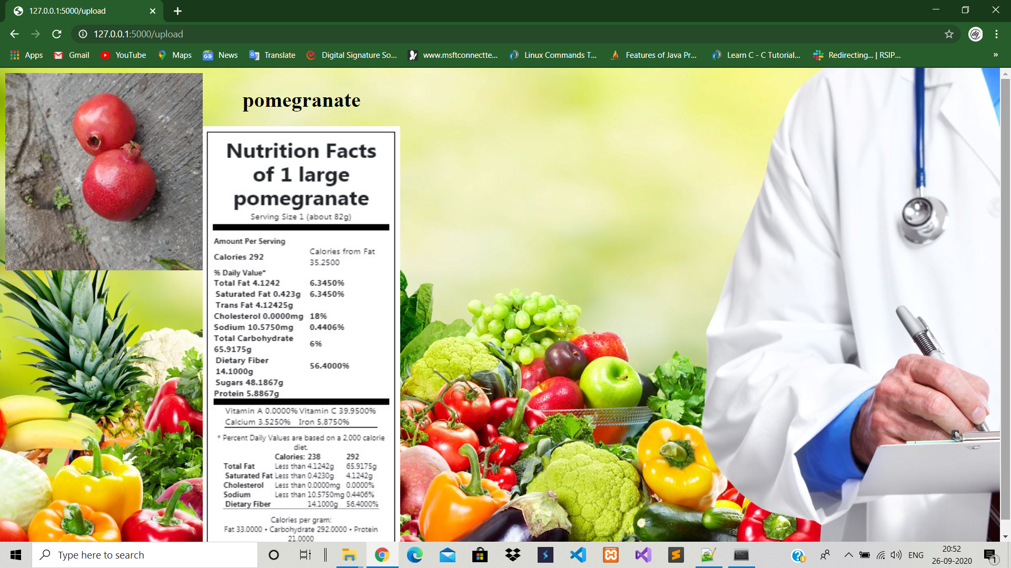
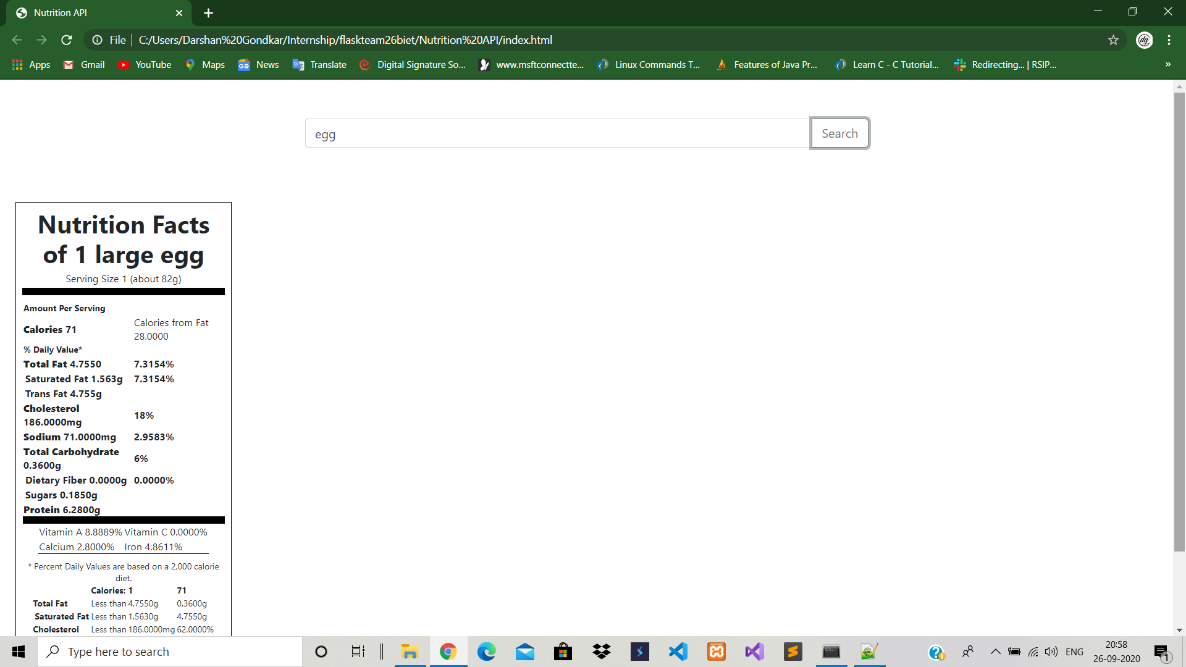
Conti..
(b) Fig:2- After click on predict button to see the output, it displays name of fruit along with its nutrition chart.
(c) Fig:3- This is the nutrition API interface, where you can enter name of food or fruit, it shows the nutrition chart of respective item.

Slide 10
Advantages:
1. Nutrition Analysis of fruits is easy to implement and understand.
2. Some processed fruits and homemade apple juice, grape juice are healthy choices that can be harmless.
3. It is applicable in training and test-time
4. It tells the nutritional value of the fruit just by seeing the fruit image.
Disadvantages:
1. It produces correlated images.
2. It easily generates anatomically incorrect examples.

Slide 11
CONCLUSION:
1) The deep neural network is trained with around 6 varieties of fruits. The intention is to get a neural network that can identify a wider array of objects from the image. The segmentation of image algorithm is a very useful processing of image method, and it is extremely useful for post-processing. An overall accuracy of 90% is achieved.
2) In the future work, we plan to create a mobile application which takes the picture of fruits and labels them accordingly. Another object is to expand the training and testing sets to include more items. This is time-consuming process since we want to include the items that were not used in most other examples.

Slide 12
THANK YOU !!

